Slide 1


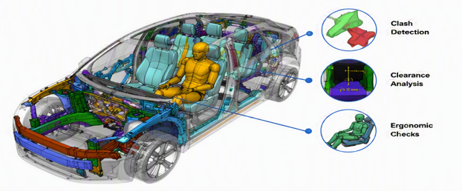












RCC (Rule Checks & Compliance) – Automation Framework & Benefits
TATA TECHNOLOGIES
Automated Vehicle Assembly Validation & Multi-Format Compliance Engine using Dassault Systèmes 3DEXPERIENCE
PROJECT CONTEXT & SERVICE SCOPE
Project
CAD Data Quality Checks
Customer
Vehicle Architecture
Platform
3DEXPERIENCE App
Collect & assemble CAD from multi-suppliers
Validate assemblies against architecture rules
Interference & Clash Detection
Ergonomic checks using Digital Mannequins
Clearance & Contact Analysis
Early issue correction before plant release
1,000+ Automated Checks Roadmap target: 2,000+ checks
Effort Cut by 95% From months to a few days
TECHNOLOGIES USED (AUTOMATION PIPELINE)
BUSINESS BENEFITS
Automated Validation
Reduced Effort
EKL Scripting
Visual Scripting
EKL Scripting
VBA Automation
Automated checks of complex vehicle assemblies.
Significant cut in manual review effort.
•
Access assembly & CAD data from 3DEXPERIENCE
•
Construct visual validation workflows
•
Generate interactive 3D validation reports
•
Generate Excel compliance reports
•
Execute compliance checks & validations
•
Execute assembly rule checks
•
Capture issue references & screenshots
•
Summarize rule validation results
Standardized Process
Faster Decisions
Repeatable, profile-driven validation.
Audit-ready Excel & 3D reports for release.
•
Generate automated 3D validation reports
•
Perform automated compliance verification
•
Maintain geometry context
•
Provide issue tracking information
Improved Quality
Early Issue Detection
Higher CAD data quality before plant release.
Catches clashes & ergonomic issues early.
© Copyright 2026 Tata Technologies. All rights reserved.
Dassault Systèmes 3DEXPERIENCE® Quality Rules Designer App

Slide 2



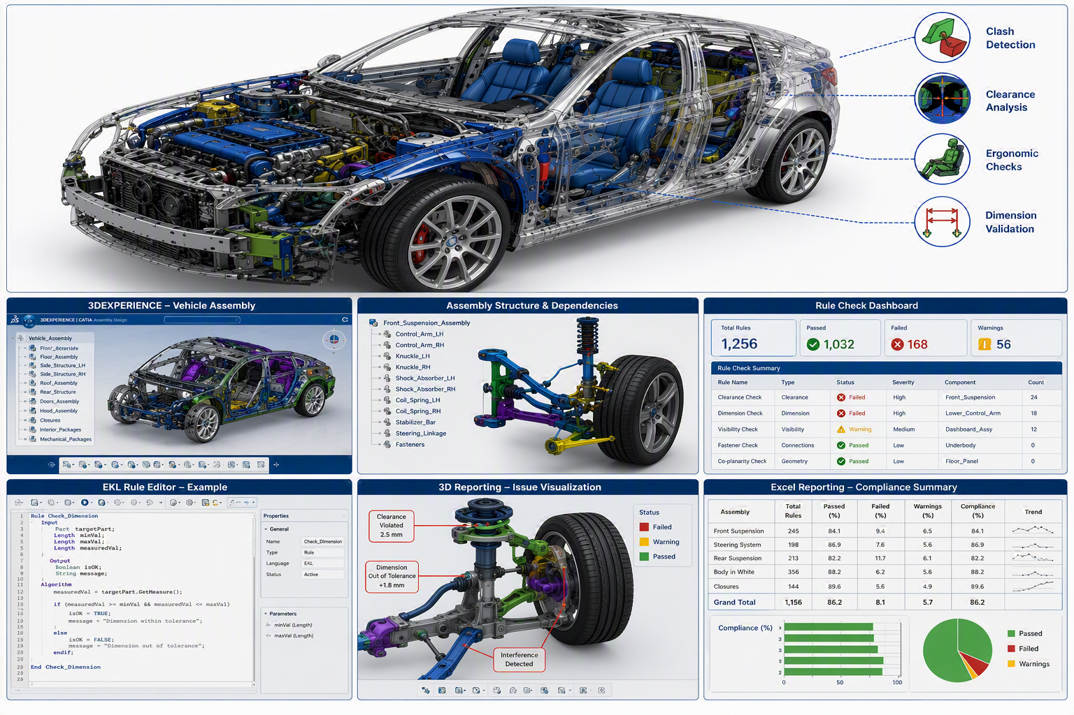
























CAD Data Quality Checks — 3DEXPERIENCE Framework
TATA TECHNOLOGIES
Automated PLM Rule-Based Validation & Business Benefits for Automotive Vehicle Assembly
PROJECT OVERVIEW & SERVICE SCOPE
Project
CAD Data Quality
Customer
American Automaker
Platform
Quality Rules Designer
Profile creation using Profile Manager
Object-type specific validation rules
Automated quality report generation
Results saved for historical reference
Rule Validation Automated
Quality Reports One-Click
Data Traceability Fully Tracked
Reusable Profiles Standardized
CAD DATA QUALITY CHECKS — TECHNOLOGY FRAMEWORK
BUSINESS BENEFITS
Improved CAD Quality
Standardized Process
Setup
Rules
Execution
Reporting
Results
Higher consistency across data.
Repeatable validation runs.
•
Create Profile via Profile Manager
•
Configure quality rules
•
Run Quality Checker
•
Generate detailed reports
•
Save results for reference
•
Define scope & objects
•
Set object parameters
•
Validate assembly rules
•
Capture metrics & issues
•
Traceability tracking
Faster Resolutions
Reduced Effort
Early issue identification.
Lower manual dependency.
Reusable Profiles
Better Traceability
Increased workflow efficiency.
Audit-ready compliance data.
OUTCOME
Established a standardized, automated CAD data quality validation framework within 3DEXPERIENCE, enabling consistent rule-based verification, improved traceability, reduced manual effort, and enhanced engineering data quality.
© Copyright 2026 Tata Technologies. All rights reserved.
Dassault Systèmes 3DEXPERIENCE® Quality Rules Designer App

